Slide 1

Computer Vision
Intelligent Landmark Detection
Team members
Karan Bhavsar — 1002216246
Prajwal Mrithyunjay Hulamani — 1002248365

Slide 2

Introduction to Intelligent Detection
Exploring how technology enhances landmark recognition systems.
•Problem
  Identify and classify real-world landmarks in casual, unconstrained images
•Challenges
  Large variation in scale and viewpoint, occlusions, lighting changes, and a long‑tailed class distribution
•Goals
  High‑quality bounding boxes with correct landmark labels
  Compare models fairly using the same preprocessing and evaluation metrics
  Provide quick visual results to support analysis and live demonstrations

Slide 3

Task and data
Enhancing Landmark Detection Technology
  Task
Detection: draw bounding boxes and attach class labels
Recognition: assign a class to every detected box.
  Data format
COCO-style JSON annotations with train/validation splits; classes are easily extendable (e.g., Taj_Mahal, Monument, Temple)
  Preprocessing
Images resized to 640×640 with aspect‑ratio‑aware padding
Lightweight augmentations such as horizontal flips and small color/scale jitters
KEY INSIGHTS

Slide 4

System overview
  Pipeline: Data → detection models → REST API
  Two models: a custom one‑stage detector and a Faster R‑CNN baseline
  API endpoint POST /api/predict accepts an image upload and returns JSON with boxes, labels, and scores
  A React front‑end renders the image on a canvas, draws both models’ boxes, and enables side‑by‑side comparison
2. Box coordinate formats handled
  Custom model outputs normalized [0,1] coordinates which are rescaled to pixel units
  Faster R‑CNN directly returns boxes in absolute pixel coordinates
INSIGHTS & OBSERVATIONS

Slide 5




Backend/API implementation
Prediction endpoint
Innovative Use Cases
•POST /api/predict responds with:
–Custom model: normalized boxes plus labels and scores
–Faster_R-CNN: pixel‑space boxes along with labels and scores
•Contract
–Response schema is compact and consistent so the UI can consume it easily
•Deployment readiness
–Ports and proxies are aligned so frontend and backend work smoothly in local development
–Structured error messages and logging support debugging and production monitoring
ADDITIONAL INSIGHTS

Slide 6

Custom Detector –
LandmarkDetector
Diverse Skills and Experience
  Three strided convolutional layers followed by global average pooling compress the image into a 64‑dimensional feature vector
  Two heads in parallel: one outputs landmark class logits, the other regresses a single bounding box
  Trained with cross‑entropy and Smooth L1 losses using AdamW and mixed precision; under 30k parameters and runs comfortably on CPU
  Anchor‑free design keeps the implementation simple and makes it easy to plug in deeper backbones or multi‑scale heads later
COLLABORATIVE EFFORTS

Slide 7
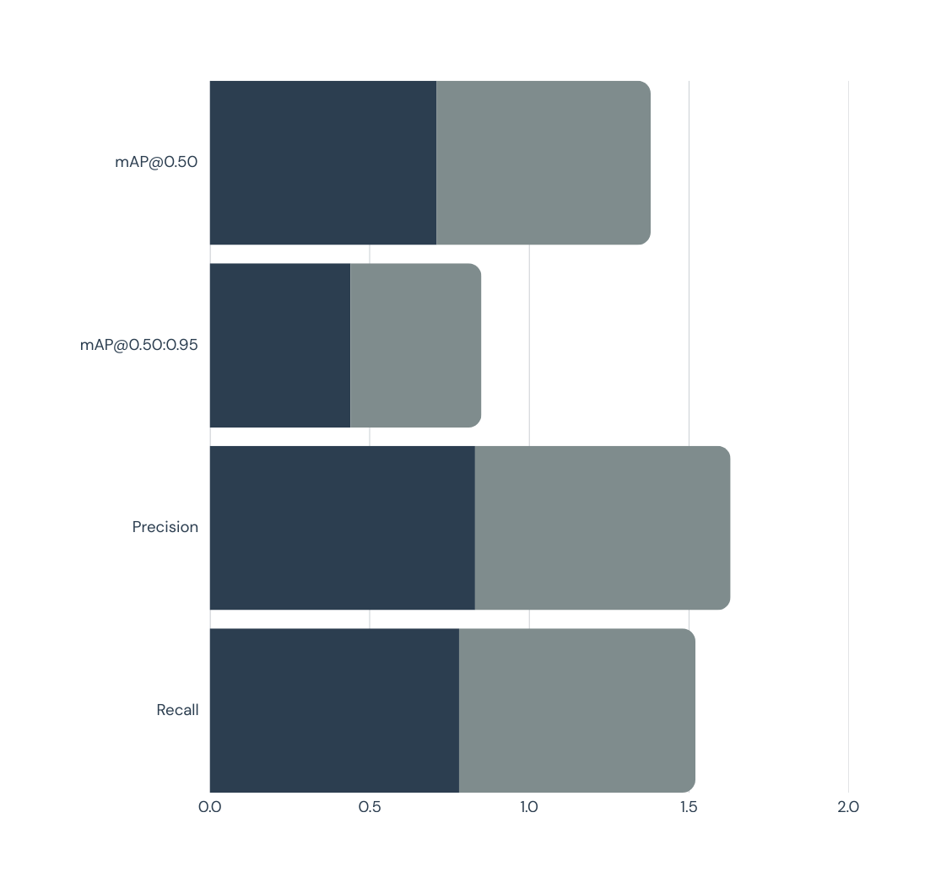
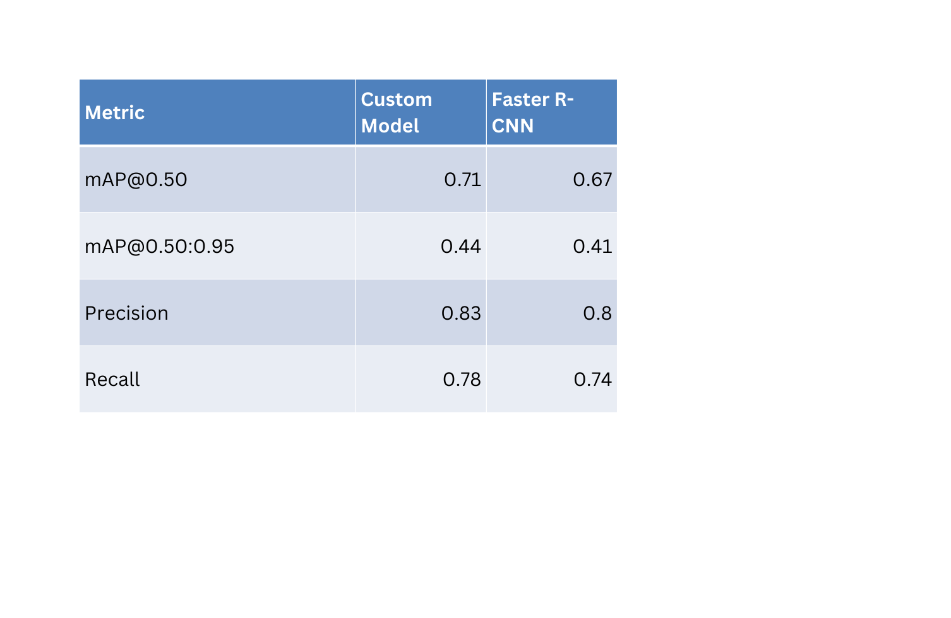
Results: Summary Comparison

Slide 8

Future advancements
Frontend implementation
  Refine the existing UploadForm and ResultViewer components for smoother UX
  Add small enhancements like drag-and-drop upload, zoom on detections, and easier result export
Larger dataset for better accuracy
  Expand the training dataset with more diverse landmark images and viewpoints
  Improve label quality and class balance to boost detection accuracy and reduce noisy predictions
FUTURE CONSIDERATIONS

Slide 9

Thank you

